Slide 1

COMPUTER NETWORK (BCA301)
DEPARTMENT OF COMPUTER SCIENCE
PROGRAMME: BCA
CENTRAL UNIVERSITY OF ORISSA
KORAPUT

Slide 2
ERROR DETECTION AND CORRECTION
Data can be corrupted during transmission.
Some applications require that errors be detected and corrected.
Types of Errors:
Single bit error: The term single bit error means that only 1 bit of given data unit is changed from 1 to 0 or 0 to 1.
These errors are the least likely type of error in serial data transmission .
Burst error :The term burst error means that 2 or more bits in the data unit have changed from 1 to 0 or from 0 to 1.
The length of the burst is measured from the first corrupted bit to the last corrupted bit.
A burst error is more likely to occur than a single-bit error.

Slide 3
REDUNDANCY
The central concept in detecting or correcting errors is redundancy .
The redundant or Extra bits are added by the sender and removed by the receiver.
DETECTION VERSUS CORRECTION:
The correction of errors is more difficult than the detection.
In error correction, we need to know the exact number of bits that are corrupted and more importantly, their location in the message.
Two main methods of error correction :
FORWARD ERROR CORRECTION :
It is the process in which the receiver tries to guess the message by using redundant bits.
RETRANSMISSION:
It is a technique in which the receiver detects the occurrence of an error and asks the sender to resend the message.
Resending is repeated until a message arrives that the receiver believes is error-free.

Slide 4
CODING
Redundancy is achieved through various coding schemes.
The sender adds redundant bits through a process that creates a relationship between the redundant bits and the actual data bits.
The receiver checks the relationships between the two sets of bits to detect or correct the errors.
The ratio of redundant bits to the data bits and the robustness of the process are important factors in any coding scheme.
We can divide coding schemes into two broad categories:
Block coding and
Convolution coding

Slide 5
MODULAR ARITHMETIC
In modulo-N arithmetic, we use only the integers in the range 0 to N - 1, inclusive.
If the modulus is 12, we use only the integers 0 to 11, inclusive.
Example: Our clock system.
There is no carry when you add two digits in a column.
There is no carry when you subtract one digit from another in a column.
Modulo-2 Arithmetic : Adding : 0+0=0 0+1=1 1+0=1 1+1=0
Subtracting : 0-0=0 0-1=1 1-0=1 1-1=0
In this arithmetic we use the XOR (exclusive OR) operation for both addition and subtraction.

Slide 6
BLOCK CODING
The message is divided into blocks, each of k bits, called datawords.
We add r redundant bits to each block to make the length n = k + r.
The resulting n-bit blocks are called Codewords.
We have a set of datawords, each of size k, and a set of codewords, each of size of n.
With k bits, we can create a combination of 2^{k} datawords; with n bits, we can create a combination of 2^{n} codewords.
Since n > k, the number of possible codewords is larger than the number of possible datawords.
The block coding process is one-to-one; the same dataword is always encoded as the same codeword.
This means that we have 2^{n} - 2^{k} codewords that are not used. We call these codewords invalid or illegal.

Slide 7
Errors Detection by using Block Coding
If the following two conditions are met, the receiver can detect a change in the original codeword.
The receiver has (or can find) a list of valid codewords.
The original codeword has changed to an invalid one.
The sender creates codewords out of datawords by using a generator that applies the rules and procedures of encoding.
Each codeword sent to the receiver may change during transmission.
If the received codeword is the same as one of the valid codewords, the word is accepted; the corresponding dataword is extracted for use.
If the received codeword is not valid, it is discarded. However, if the codeword is corrupted during transmission but the received word still matches a valid codeword, the error remains undetected.
This type of coding can detect only single errors.

Slide 8
Error Correction
Error correction is much more difficult than error detection.
In error detection, the receiver needs to know only that the received codeword is invalid; in error correction the receiver needs to find (or guess) the original codeword sent.
We can say that we need more redundant bits for error correction than for error detection.
Hamming Distance: It is the concepts in coding for error control.
The Hamming distance between two words (of the same size) is the number of differences between the corresponding bits.
The Hamming distance between two words x and y as d(x, y).
Calculation: Apply the XOR operation on the two words and count the number of 1’s in the result.
The Hamming distance is a value greater than zero.

Slide 9

Example
Find the Hamming distance between two pairs of words.
The Hamming distance d(000, 011) is 2 because
The Hamming distance d(10101, 11110) is 3 because
Find the minimum Hamming distance of the coding?
We first find all Hamming distances.
The dmin in this case is 2.
The dmin in this case is 3.

Slide 10
Coding Scheme with Three Parameters
The codeword size n, the dataword size k, and the minimum Hamming distance dmin.
A coding scheme C is written as C(n, k) with a separate expression for dmin.
coding scheme C(3, 2) with dmin =2 and coding scheme C(5, 2) with dmin = 3

Slide 11
Minimum Distance for Error Detection
If ‘s’ errors occur during transmission, the Hamming distance between the sent codeword and received codeword is ‘s’.
If our code is to detect up to ‘s’ errors, the minimum distance between the valid codes must be s + 1, so that the received codeword does not match a valid codeword.
In other words, if the minimum distance between all valid codewords is s + 1, the received codeword cannot be erroneously mistaken for another codeword.
To guarantee the detection of up to s errors in all cases, the minimum Hamming distance in a block code must be dmin = s + 1.

Slide 12
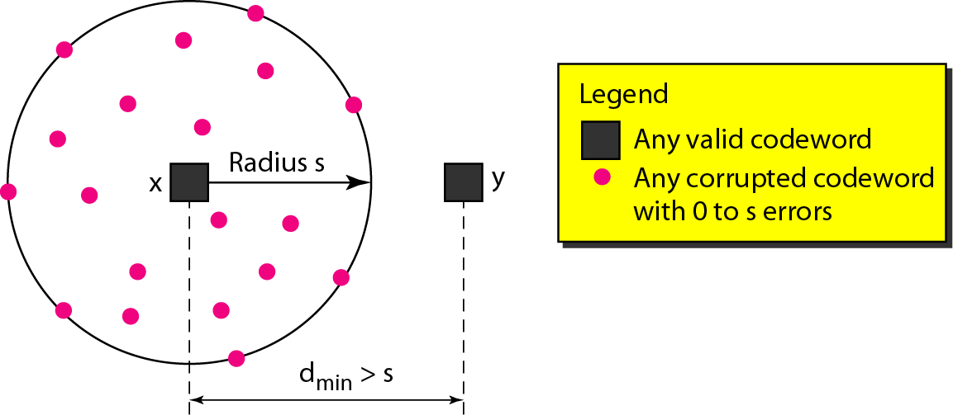
Geometric Concept For Finding dmin in Error Detection

Slide 13
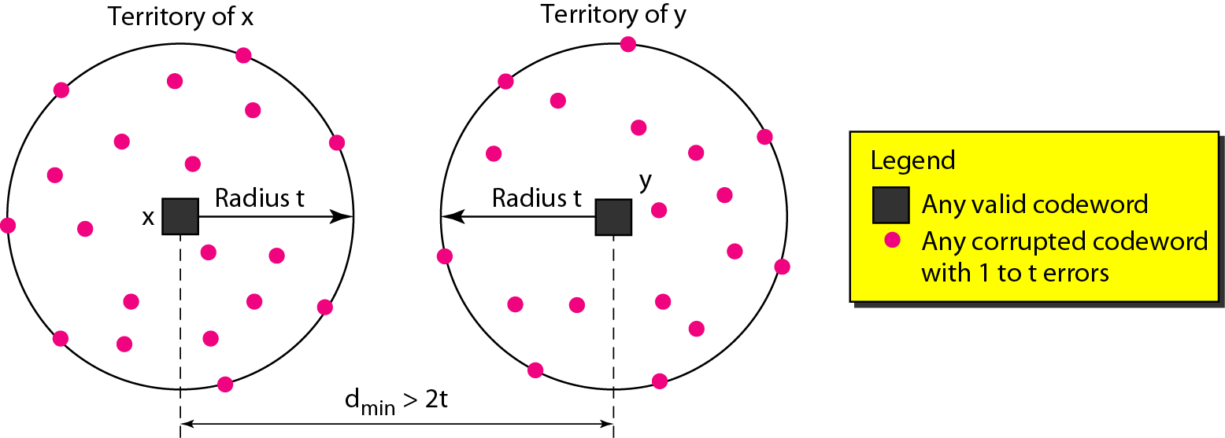
Geometric Concept For Finding dmin in Error Detection

Slide 14
Linear Clock Code
A linear block code is a code in which the exclusive OR (addition modulo-2) of two valid codewords creates another valid codeword.
A simple parity-check code is a single-bit error-detecting code in which n = k + 1 with dmin = 2.
Even parity (ensures that a codeword has an even number of 1’s) and odd parity (ensures that there are an odd number of 1’s in the codeword)

Slide 15
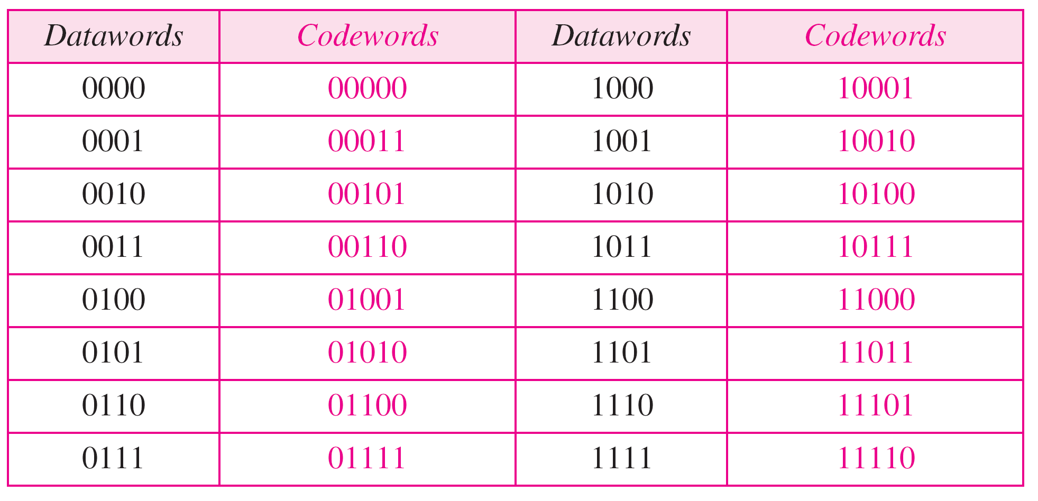

Slide 16
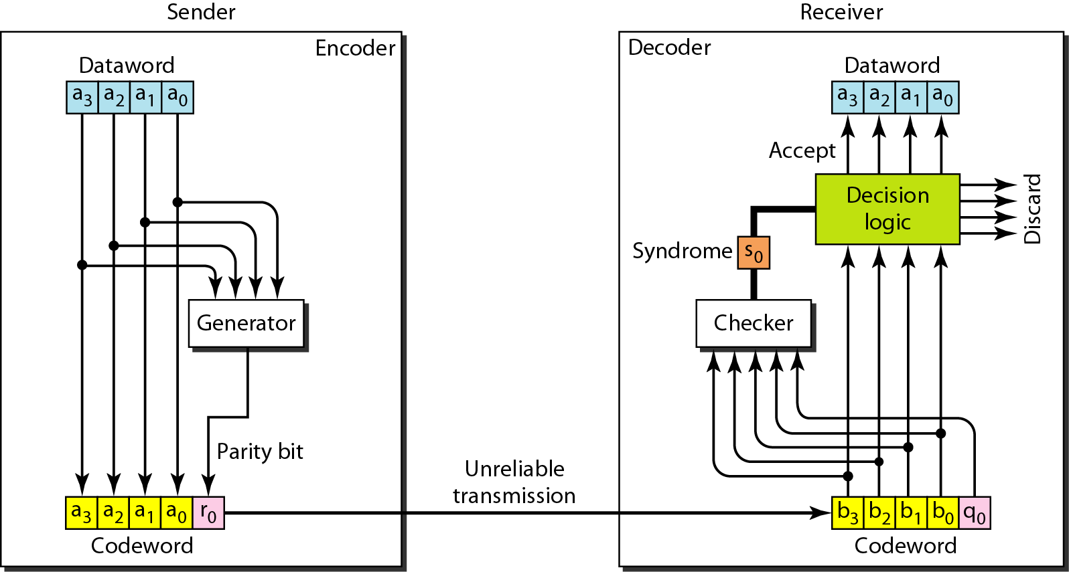
Encoder and Decoder For Simple Parity-Check Code

Slide 17
Let us look at some transmission scenarios. Assume the sender sends the dataword 1011. The codeword created from this dataword is 10111, which is sent to the receiver. We examine five cases:
1. No error occurs; the received codeword is 10111. The syndrome is 0. The dataword 1011 is created.
2. One single-bit error changes a1 . The received codeword is 10011. The syndrome is 1. No dataword is created.
3. One single-bit error changes r0 . The received codeword is 10110. The syndrome is 1. No dataword is created.

Slide 18
4. An error changes r0 and a second error changes a3 .
The received codeword is 00110. The syndrome is 0. The dataword 0011 is created at the receiver. Note that here the dataword is wrongly created due to the syndrome value.
5. Three bits—a3, a2, and a1—are changed by errors. The received codeword is 01011. The syndrome is 1. The dataword is not created. This shows that the simple parity check, guaranteed to detect one single error, can also find any odd number of errors.

Slide 19
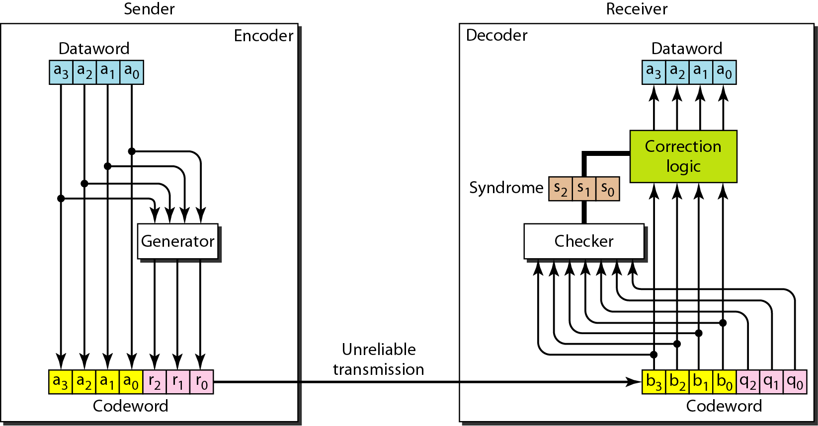
The structure of the encoder and decoder for a Hamming code

Slide 20
Hamming Code
It is a category of error-correcting codes called Hamming codes.
These codes were originally designed with dmin = 3, which means that they can detect up to two errors or correct one single error.
Although there are some Hamming codes that can correct more than one error.
The relationship between n and k in a Hamming code is, we need to choose an integer m >= 3.
The values of n and k are then calculated from m as n = 2^{m} - 1 and k = n - m.
The number of check bits r =m.
Ex: if m =3, then n = 2³ - 1 = 7 and k =n – m = 7-3= 4. This is a Hamming code C(7, 4) with d_{min} =3 .

Slide 21
A copy of a 4-bit dataword is fed into the generator that creates three parity checks r₀ , r₁ and r₂
r₀ = a₂ + a₁ + a₀ mod 2
r₁ = a₃ + a₂ + a₁ mod 2
r ₂ = a₁ + a₀ + a₃ mod 2
In other words, each of the parity-check bits handles 3 out of the 4 bits of the dataword.
The total number of 1s in each 4-bit combination (3 dataword bits and 1 parity bit) must be even.
We are not saying that these three equations are unique; any three equations that involve 3 of the 4 bits in the dataword and create independent equations (a combination of two cannot create the third) are valid.

Slide 22
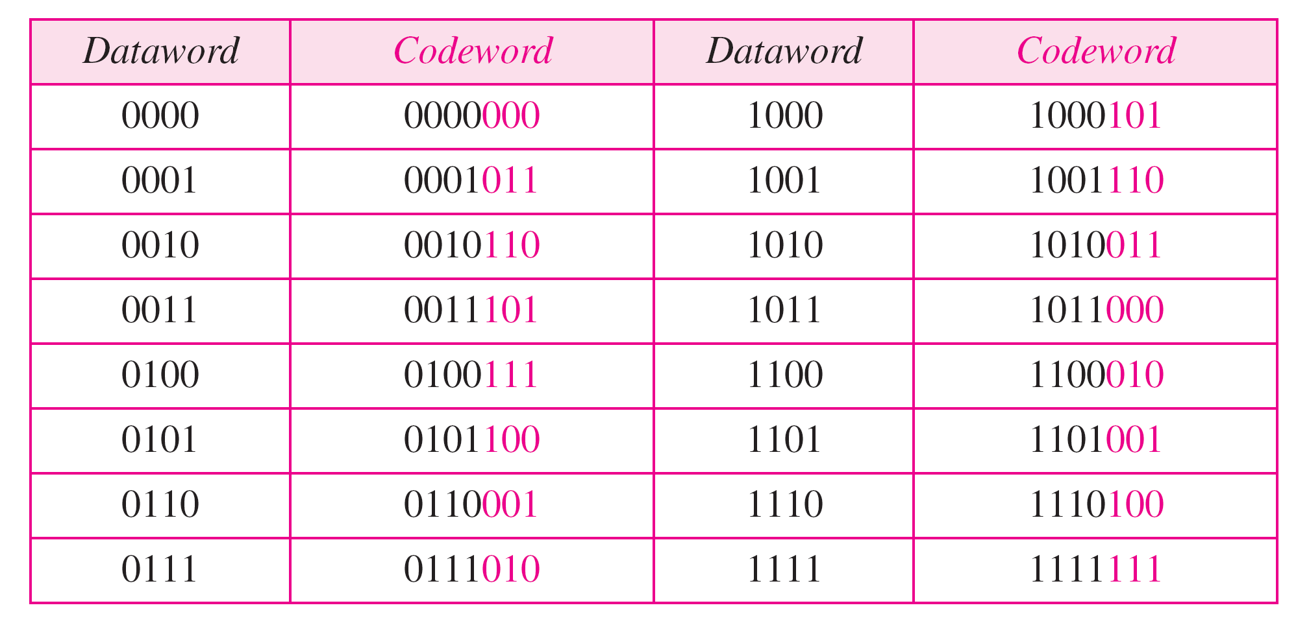

Slide 23
The checker in the decoder creates a 3-bit syndrome (s₂s₁s₀) in which each bit is the parity check for 4 out of the 7 bits in the received codeword:
S₀ = b₂ + b₁ + b₀ + q₀ mod 2
S₁ = b₃ + b₂ + b₁ + q₁ mod 2
S₂ = b₁ + b₀ + b₃ + q₂ mod 2
The equations used by the checker are the same as those used by the generator with the parity-check bits added to the right-hand side of the equation.
The 3-bit syndrome creates eight different bit patterns (000 to 111) that can represent eight different conditions.
These conditions define a lack of error or an error in 1 of the 7 bits of the received codeword .

Slide 24
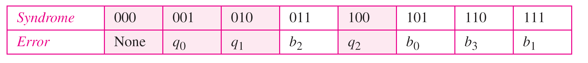
Logical decision made by the correction logic analyzer
The generator is not concerned with the four cases shaded in Table , because there is either no error or an error in the parity bit.
In the other four cases, 1 of the bits must be flipped (changed from 0 to 1 or 1 to 0) to find the correct dataword.
For example, if q_{o} is in error, S_{o} is the only bit affected; the syndrome, therefore, is 001.
If b₂ is in error, S_{o} and S₁ are the bits affected; the syndrome, therefore is O1l.
Similarly, if b₁ is in error, all 3 syndrome bits are affected and the syndrome is 111.
Note: First, if two errors occur during transmission, the created dataword might not be the right one.
Second, if we want to use the above code for error detection, we need a different design.

Slide 25
Ex: 1. The dataword 0100 becomes the codeword 0100011. The codeword 0100011 is received. The syndrome is 000 (no error), the final dataword is 0100.
2. The dataword 0111 becomes the codeword 0111001. The codeword 0011001 is received. The syndrome is 011. According to Table , b₂ is in error. After flipping b₂ (changing the 1 to 0), the final dataword is 0111.
3. The dataword 1101 becomes the codeword 1101000. The codeword 0001000 is received (two errors). The syndrome is 101, which means that b_{o} is in error. After flipping b₀, we get 0000, the wrong dataword. This shows that our code cannot correct two errors

Slide 26
To guarantee the detection of up to s errors in all cases, the minimum Hamming distance in a block code must be d_{min} =S + 1.
To guarantee correction of up to t errors in all cases, the minimum Hamming distance in a block code must be d_{min} == 2t + 1.
Ex:A code scheme has a Hamming distance dmin == 4. What is the error detection and correction capability of this scheme?
Ans : This code guarantees the detection of up to three errors (s =3), but it can correct up to one error.

Slide 27
We need a dataword of at least 7 bits. Calculate values of k and n that satisfy this requirement. Solution: We need to make k = n - m greater than or equal to 7, or 2^{m} - 1 - m >= 7. 1. If we set m =3, the result is n =2³ - 1 = 7 and
k =7 – 3 = 4, which is not acceptable. 2. If we set m =4, then n =2⁴ - 1 =15 and
k = 15 - 4 =11, which satisfies the condition. So the code is C(l5, 11).

Slide 28
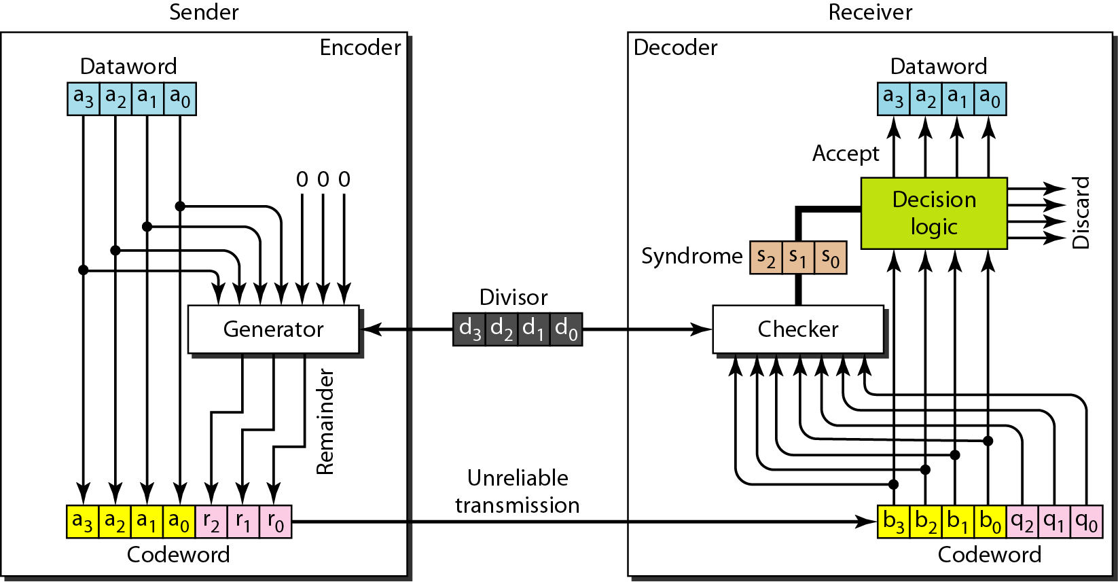
CYCLIC CODE CRC Encoder and Decoder

Slide 29
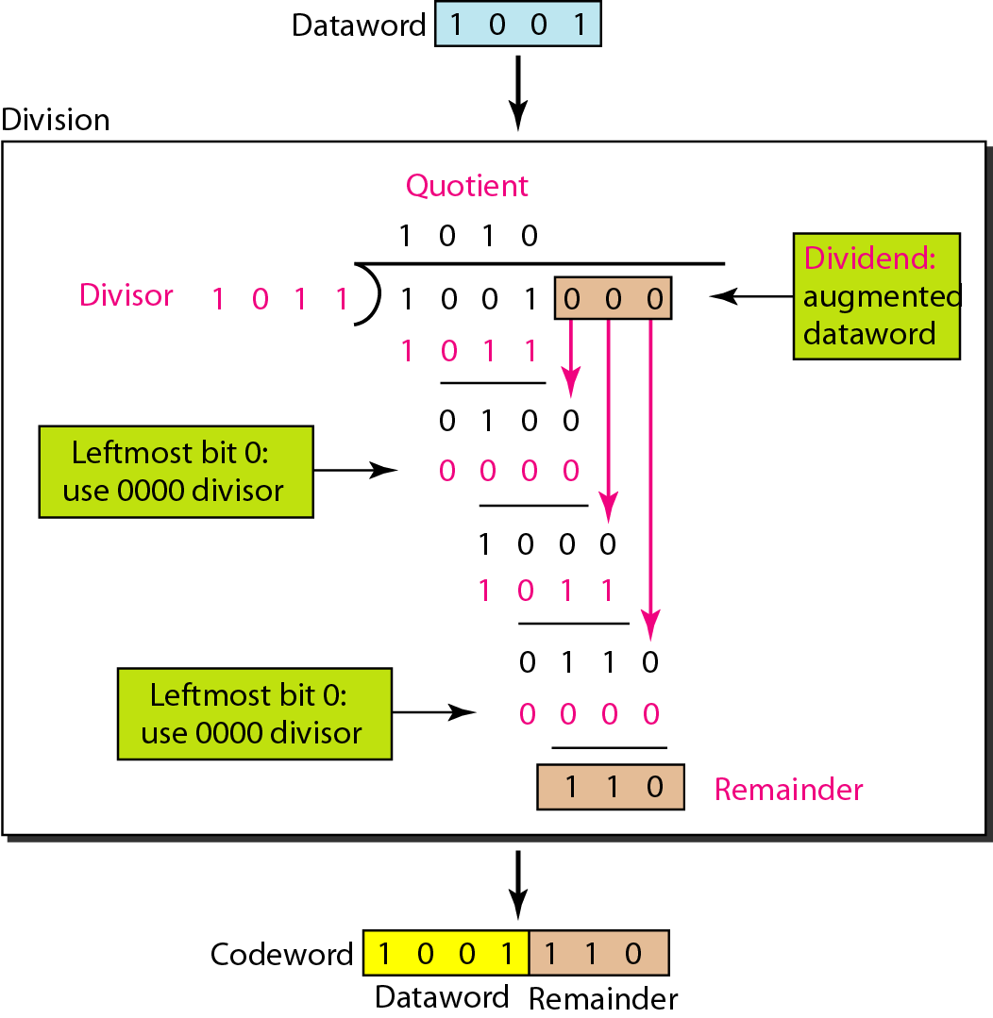
Division in CRC encoder

Slide 30
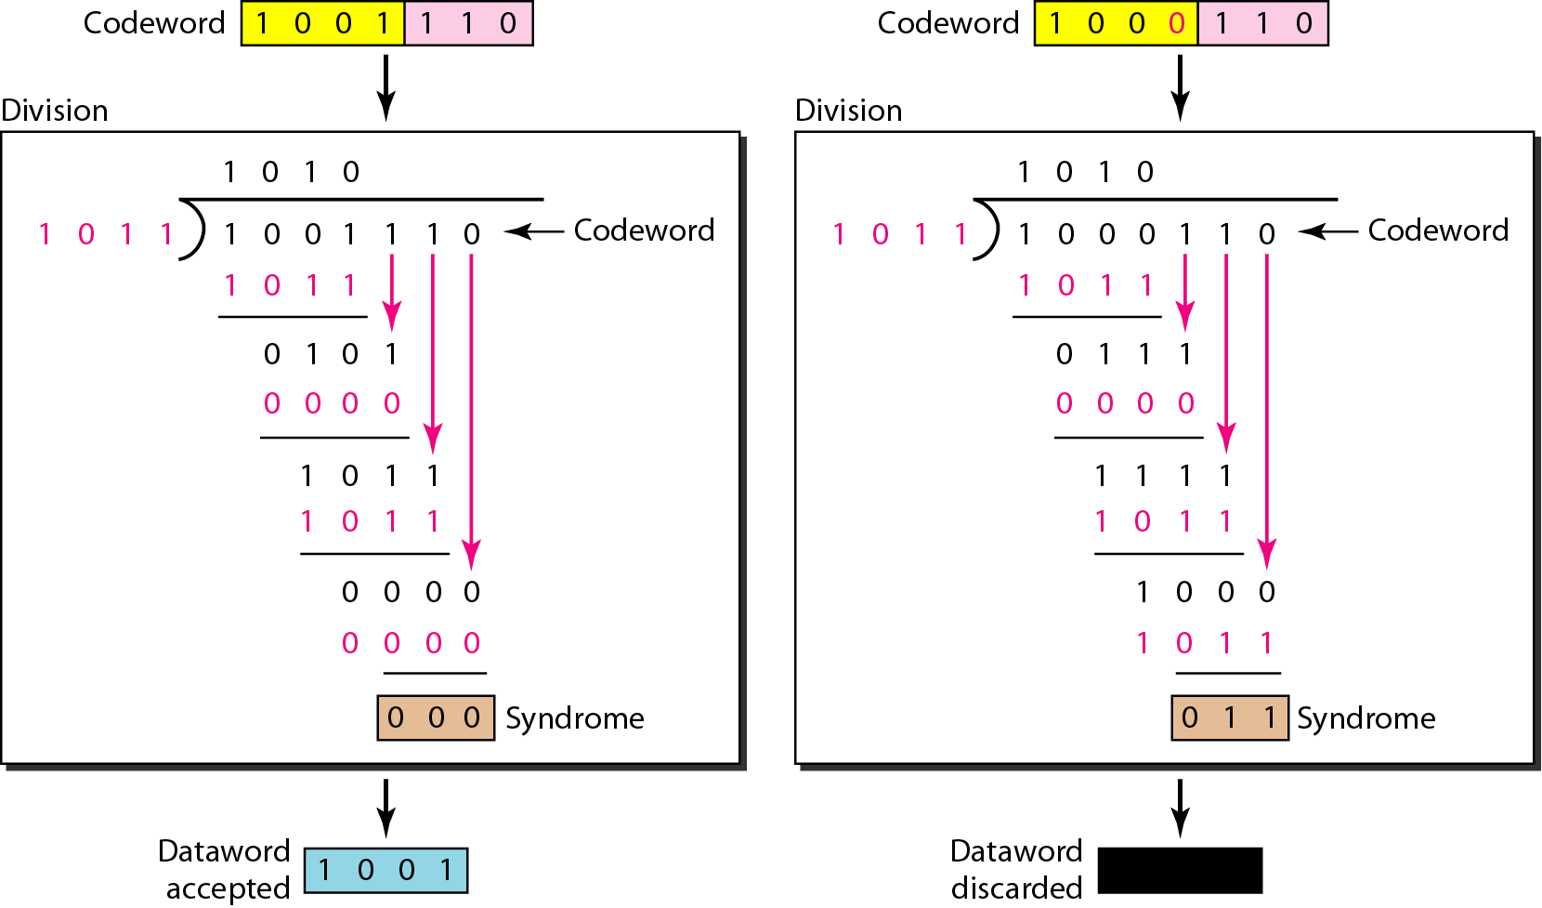
Division in the CRC Decoder For Two Cases

Slide 31
REFRENCES
“ DATA COMMUNICATIONS AND NETWORKING ”, Behrouz A. Forouzan And Sophia Chung Fegan , Fourth Edition , McGraw-Hill

